Slide 1

Movie Data Analysis Project
Uncovering trends in movie popularity and genre using Python.

Slide 2
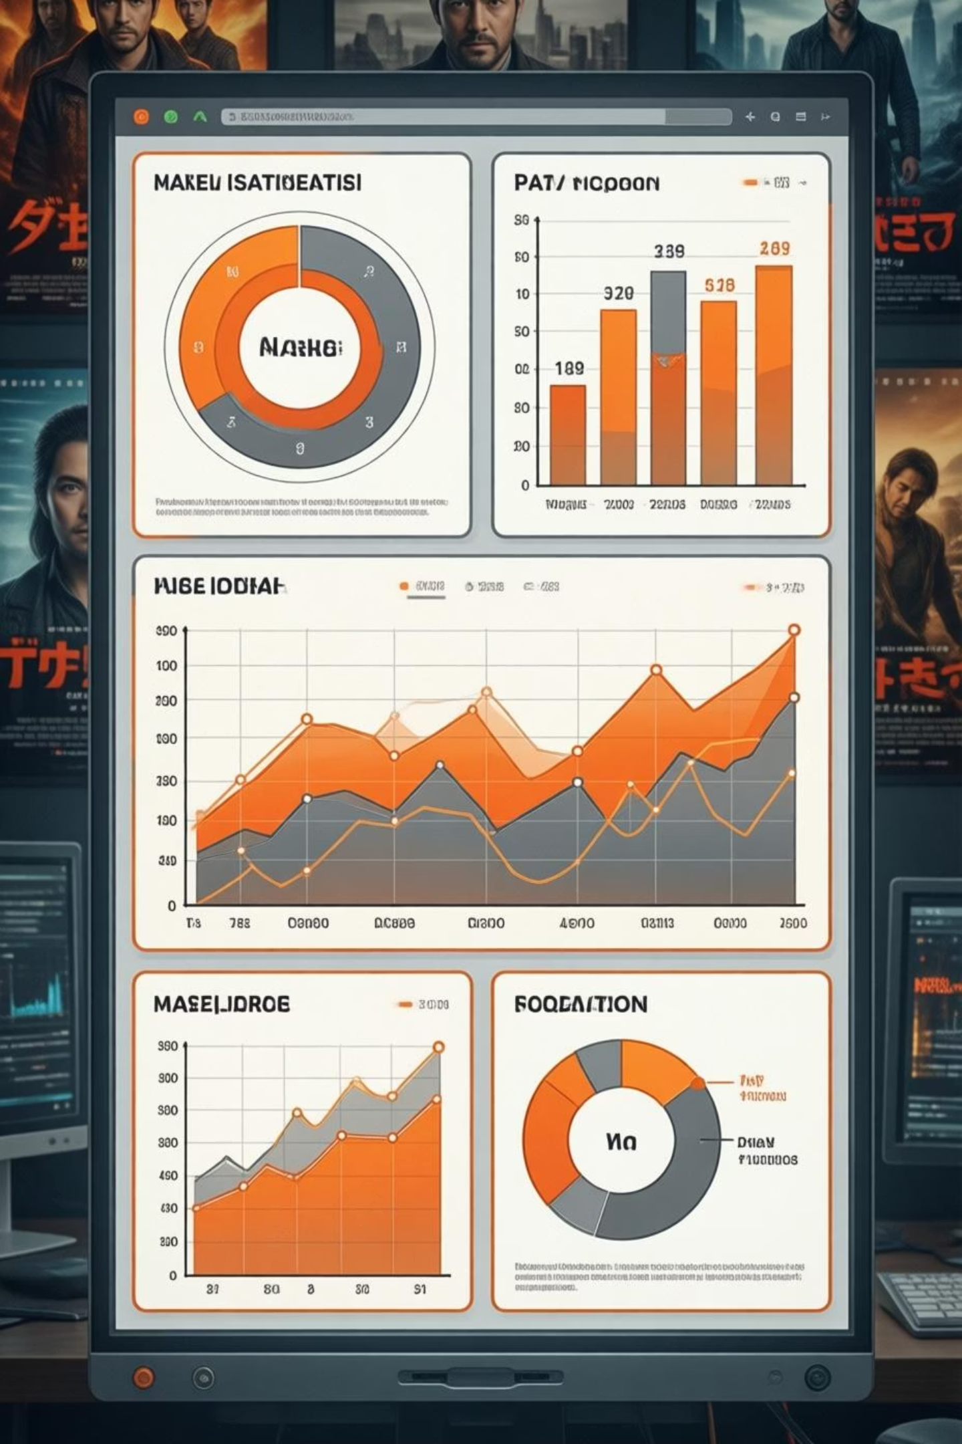
Project Objective
Analyze Movie Dataset
Identify trends in genres, popularity, voting patterns, and yearly production.

Slide 3

Dataset Overview
The dataset includes critical information for each movie:
Movie titles
Genres
Popularity scores
Vote counts
Release years
This comprehensive data allows for deep dives into various aspects of film trends.

Slide 4

Tools & Technologies
Python
Jupyter Notebook
Core programming language for analysis.
Interactive environment for coding and visualization.
Pandas
NumPy
Data manipulation and analysis library.
Numerical computing library.
Matplotlib
Seaborn
Data visualization library.
Statistical data visualization.

Slide 5

Key Finding: Drama Dominance
Drama stands out as the most prevalent genre:
Appears in over 14% of all movies.
Holds more than 18.5% share in popularity.
This indicates a strong audience preference and consistent production in the drama genre.

Slide 6

Popularity Extremes
Highest Popularity
Spider-Man: No Way Home
(Adventure, Sci-Fi)
Lowest Popularity
The United States, Thread
(Specific genre not provided)

Slide 7
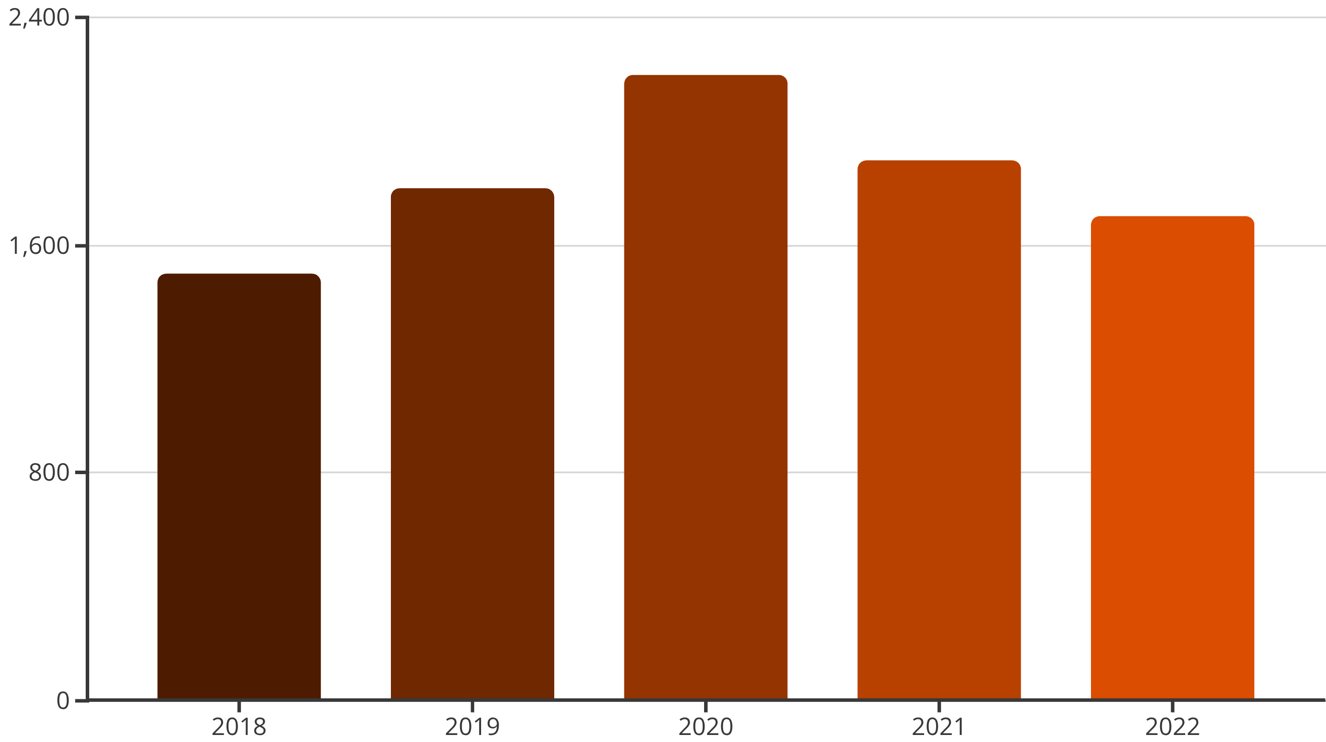
Yearly Movie Production
The year 2020 recorded the highest number of movie releases.
Despite global challenges, 2020 saw a surge in film production, possibly due to shifting industry dynamics.

Slide 8



Insights into Audience Preferences
Popularity Drivers
Blockbusters like Spider-Man dominate, but niche films also find their audience.
Genre Trends
Drama's consistent presence highlights its enduring appeal.
Production Peaks
Year 2020 as a significant year for new releases.

Slide 9

Conclusion: Data-Driven Insights
This project effectively demonstrates the power of Python-based data analysis.
It helps uncover meaningful insights into:
Movie trends
Audience preferences
Industry dynamics
Such analysis is crucial for filmmakers, distributors, and streaming platforms.

